Slide 1
The problem of overfitting
Regularization

Slide 2
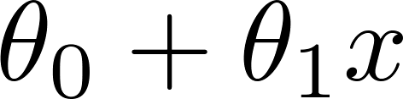
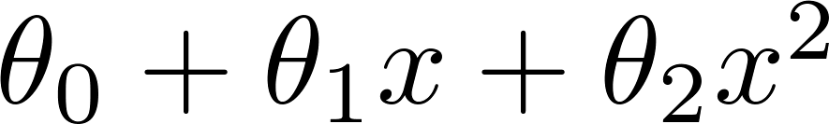
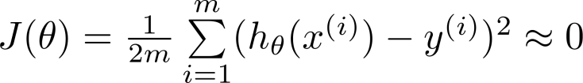
Example: Linear regression (housing prices)
Price
Price
Price
Size
Size
Size
Overfitting: If we have too many features, the learned hypothesis may fit the training set very well ( ), but fail to generalize to new examples (predict prices on new examples).

Slide 3


Addressing overfitting:
Options:
Reduce number of features.
Manually select which features to keep.
Model selection algorithm (later in course).
Regularization.
Keep all the features, but reduce magnitude/values of parameters .
Works well when we have a lot of features, each of which contributes a bit to predicting .

Slide 4
Cost function
Regularization

Slide 5


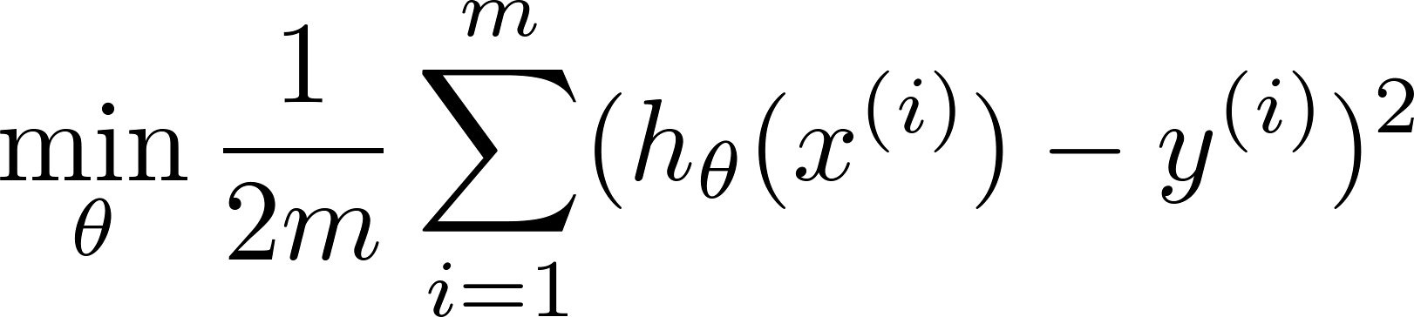
Intuition
Price
Price
Size of house
Size of house
Suppose we penalize and make , really small.

Slide 6
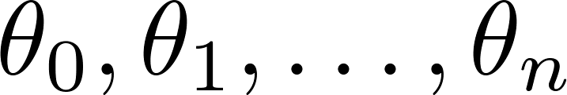
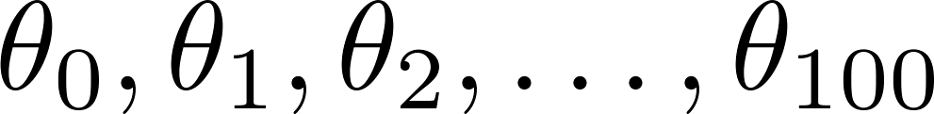
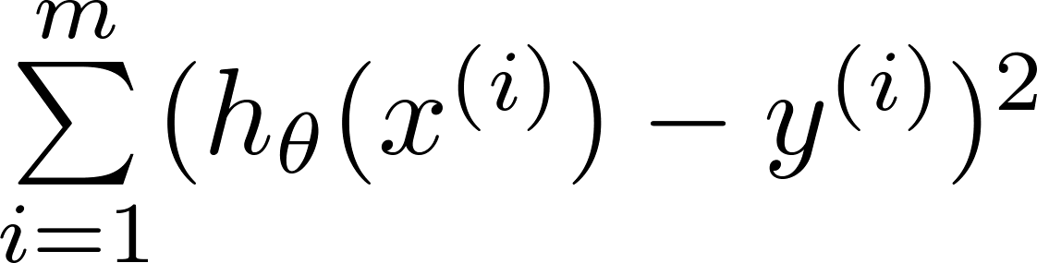
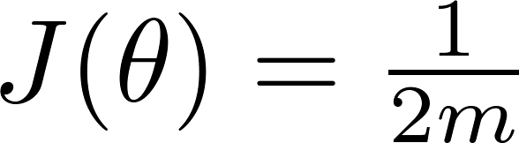
Regularization.
Small values for parameters
“Simpler” hypothesis
Less prone to overfitting
Housing:
Features:
Parameters:

Slide 7
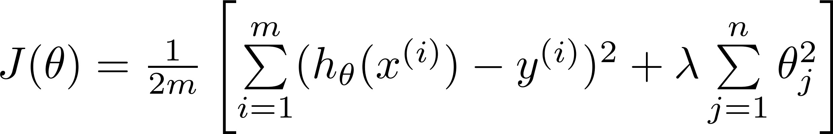
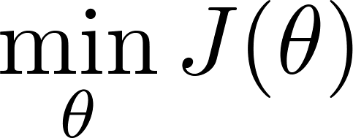
Regularization.
Price
Size of house

Slide 8


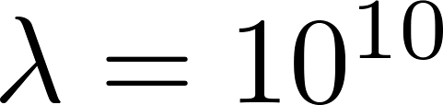
In regularized linear regression, we choose to minimize
What if is set to an extremely large value (perhaps for too large for our problem, say )?
Price
Size of house

Slide 10
Regularized linear regression
Regularization

Slide 11
Regularized linear regression

Slide 12

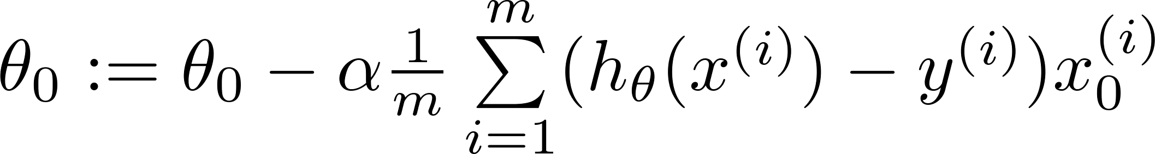
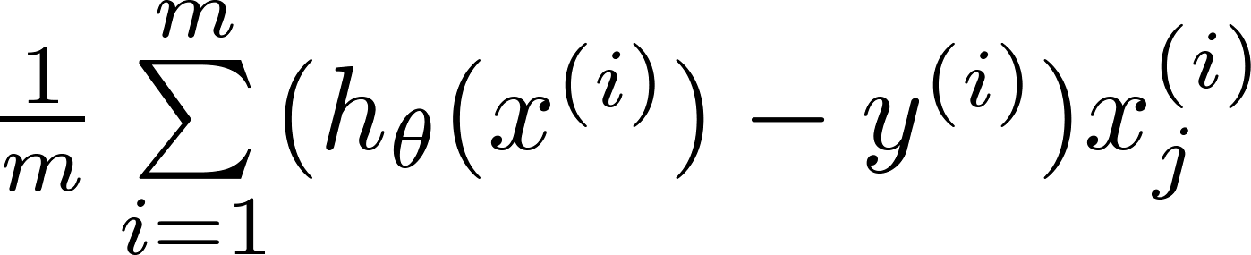
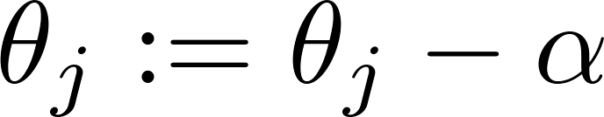


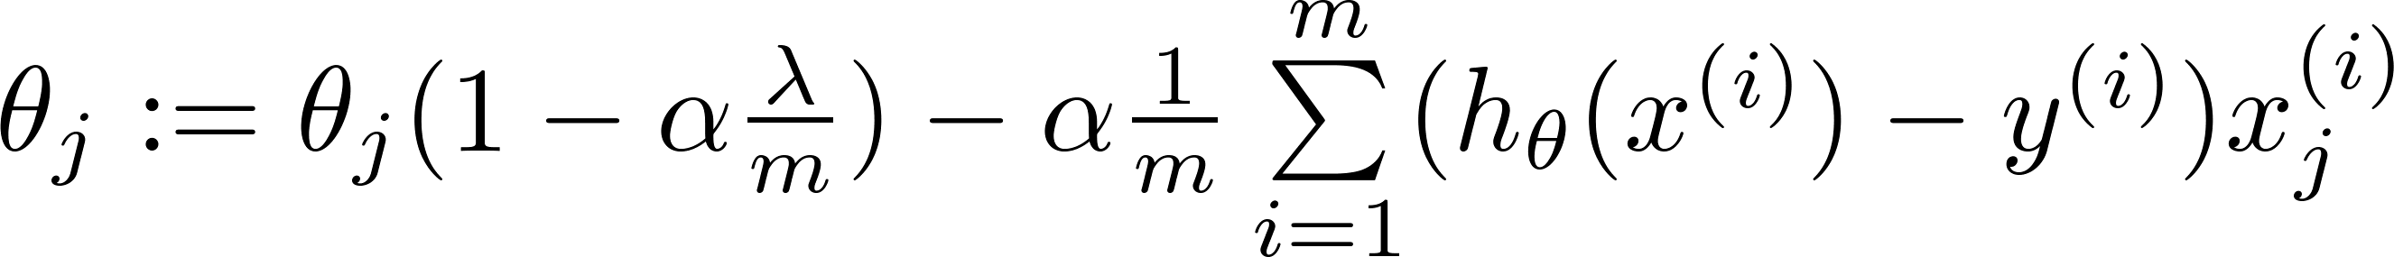
Gradient descent
Repeat

Slide 13
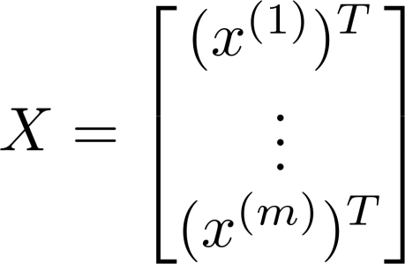
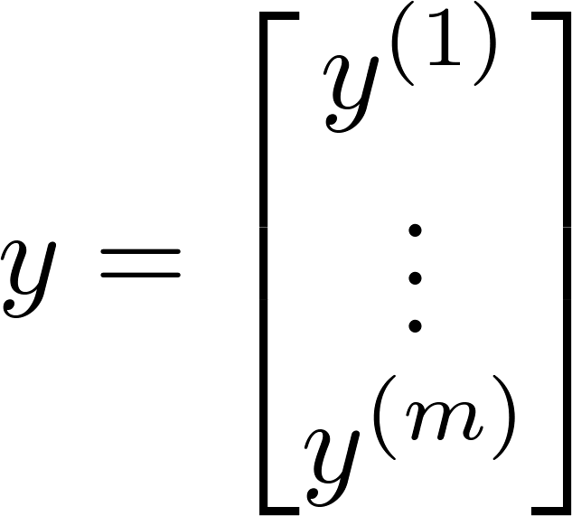
Normal equation

Slide 14
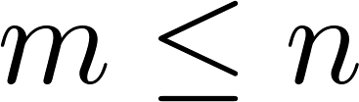
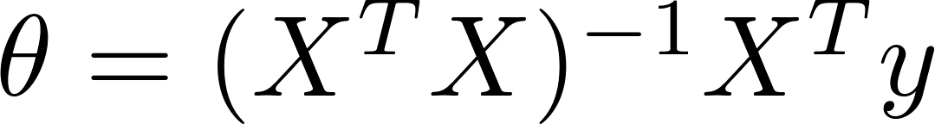

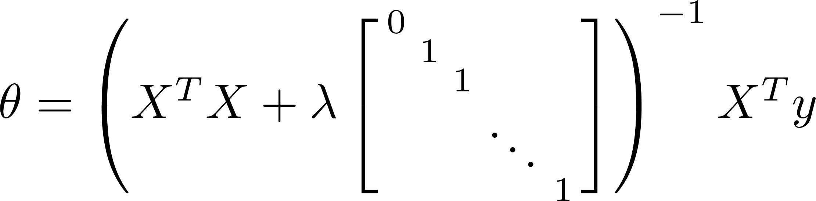
Non-invertibility (optional/advanced).
Suppose ,
(#examples) (#features)
If ,

Slide 15
References
Andrew Ng’s slides on Multiple Linear Regression from his Machine Learning Course on Coursera.

Slide 16
Disclaimer
Content of this presentation is not original and it has been prepared from various sources for teaching purpose.

